Slide 1
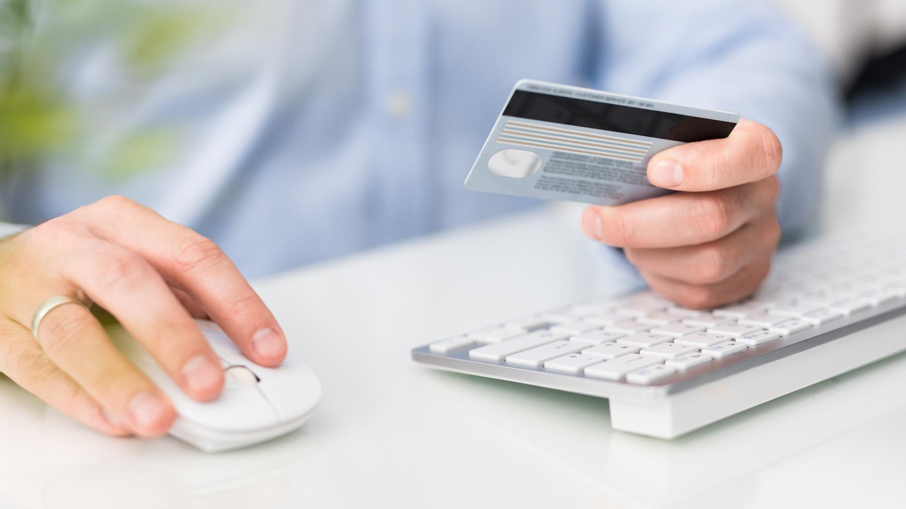
ONLINE WALLET APPLICATION

Slide 2

TEAM MEMBERS :
1. Shubham Kapoor
2.Srashti Chalisgaonkar
3. Diksha Srivastava
4.Kartik Srivastava
5. Prashant Lakhmani

Slide 3
Introduction
An Online Wallet is a software which allows a user to store, manipulate, and pay with various types of payment instruments.
It is a kind of a prepaid account in which user store his/her money for future transaction.
The main objective of online wallet is to make paperless transaction easier.

Slide 4

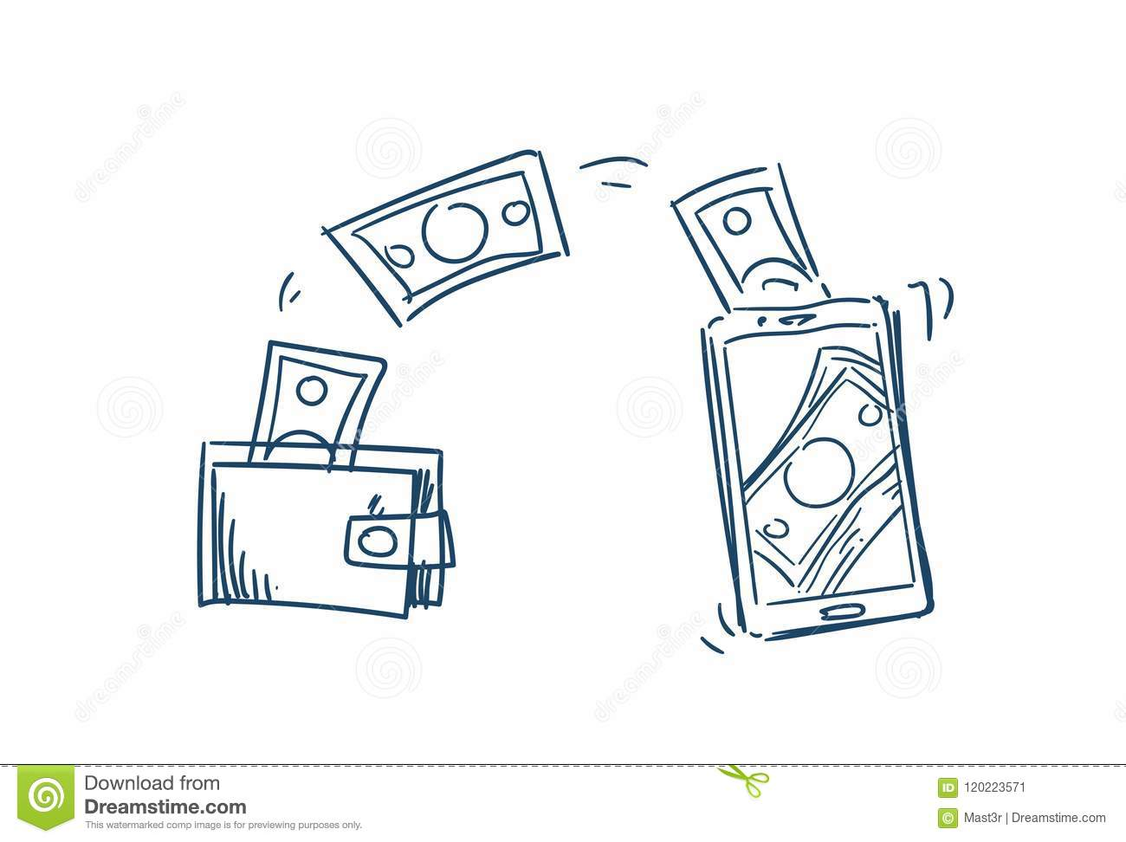


Technology Used
Spring boot for backend development.
Angular is the platform on which we developed our front end.
Testing of backend is done on postman.
The database is fetched by SQL database.
Unit testing is done with J-Unit testing framework
Wire frame for layout designing.

Slide 5
Project execution
Register & Login module
Wallet Creation module
Bank details module
Transaction module

Slide 6
Login & registration module
1. To operate the online wallet system the user has to register & then only they can login to our application.
2. At the time of registration user will be asked for the username, password and phone number
the user id has to be unique for this process.
3.After registration user directly login to the website and perform specific task.
4.For login, user needs to enter the username and password.
5.All the fields in it are mandatory to fill.

Slide 7
Wallet creation
After the registration process a wallet will be created for the registered user.
There will be a unique wallet id which will be provided to the user
3 This wallet id will be used for further
transactions.
4. The wallet id plays one of the important role.

Slide 8
Adding bank details
1. After registration user can link his/her bank account to their online wallet.
2. Fields required for this process are
->Account holder name
->IFSC code
->Bank name
3. Bank link to the wallet is important to do the further task.
4. Other functionality works only if the bank account is link to the wallet.

Slide 9

Adding money to wallet
1. After the linking of the bank account the money can be added to the wallet.
2. Without linking of the bank account this functionality will not work.
3. It is one of the easiest way to add money to wallet.
4. Money is added from the bank to the wallet.
5. Balance is updated accordingly.

Slide 10
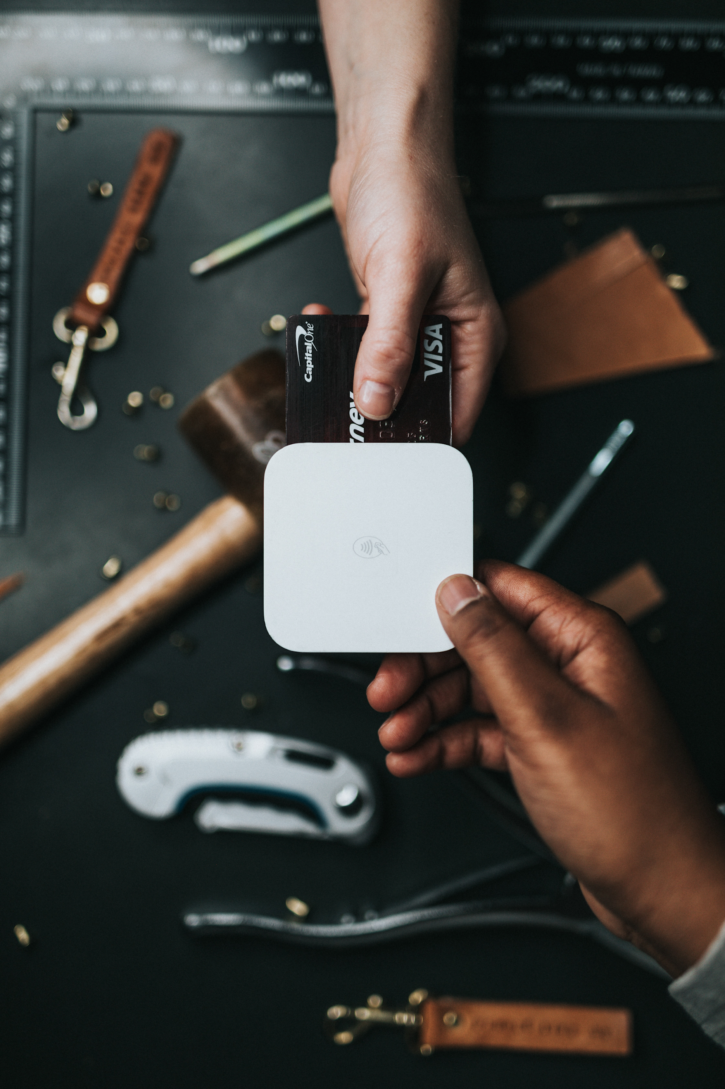
Transaction
1. Money can be transferred from one account to the other account with the help of the unique wallet id’s of both the accounts.
2.Transaction can be either financial, business or payment.
3.Wallet id is important during the transaction.
4. For this, user has to enter amount to be transferred and receiver wallet id to transfer the money.

Slide 11
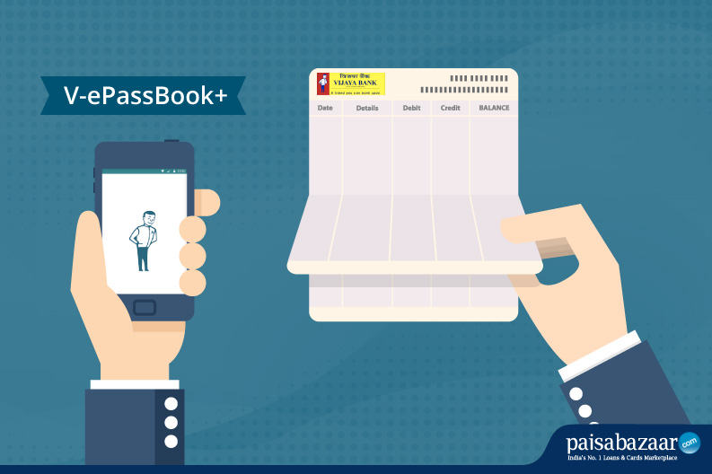
Passbook
1. This module comes under the transaction module.
2.In this, list of transaction is shown.
3. All the details related to transaction like balance, date of transaction, amount transferred , transaction id.
4. It will help the user to know about the details related to the wallet.

Slide 12
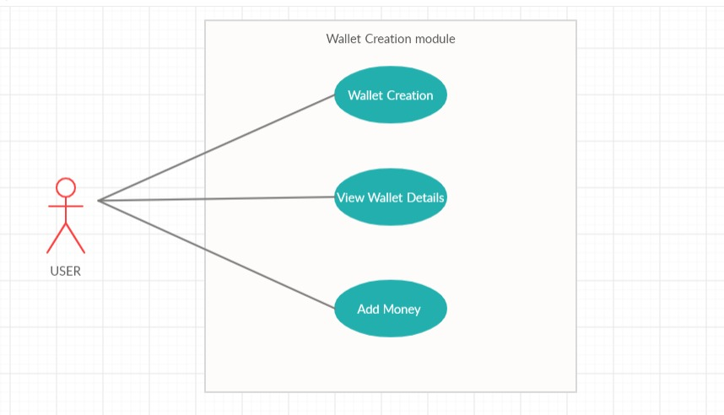

Slide 13
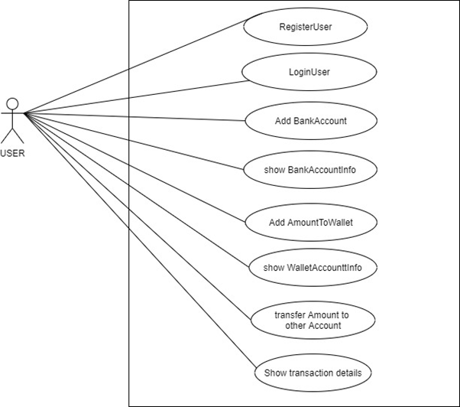
USE CASE DIAGRAM
Online wallet system

Slide 14
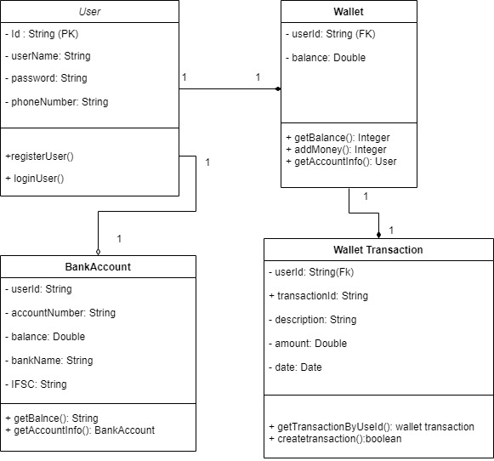
CLASS DIAGRAM
online wallet system

Slide 15
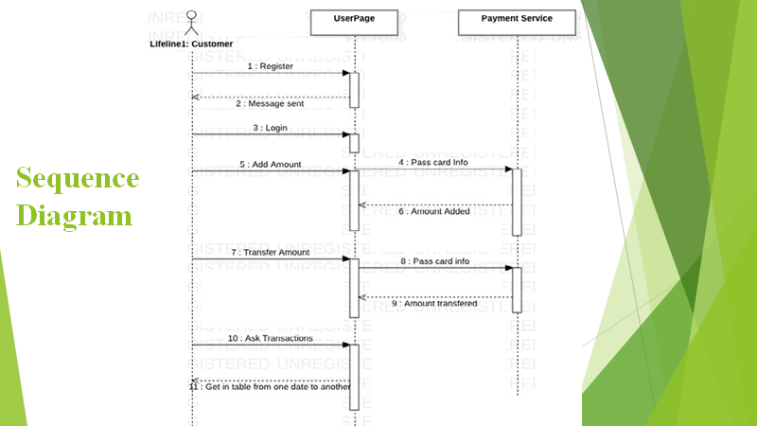
Design: Sequence Diagram

Slide 16
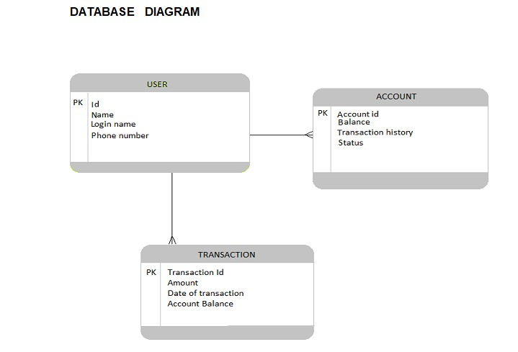

Slide 17
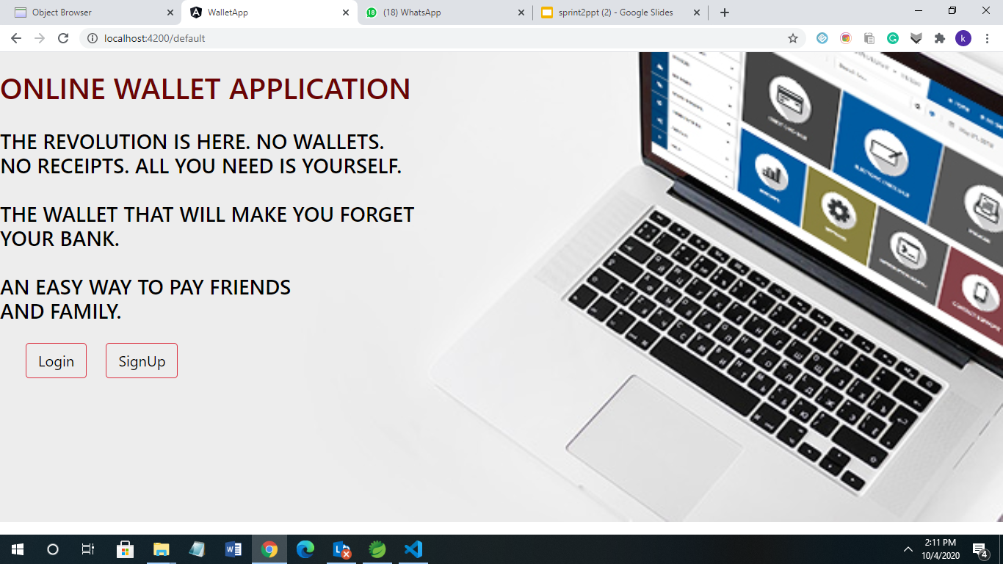
UI SCREENS:
Our UI Screens will look like this, however we have interesting patterns for individual modules....

Slide 18
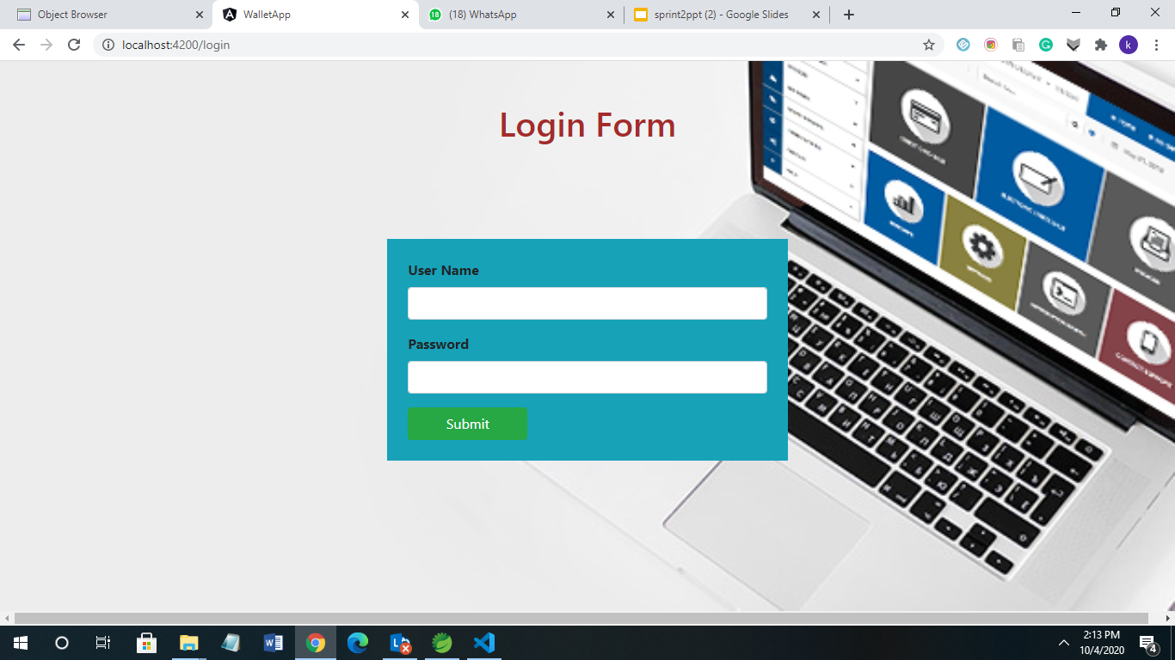
Login Pattern...
User can login with registered User Name and password...

Slide 19
Some more screens ...

Slide 20
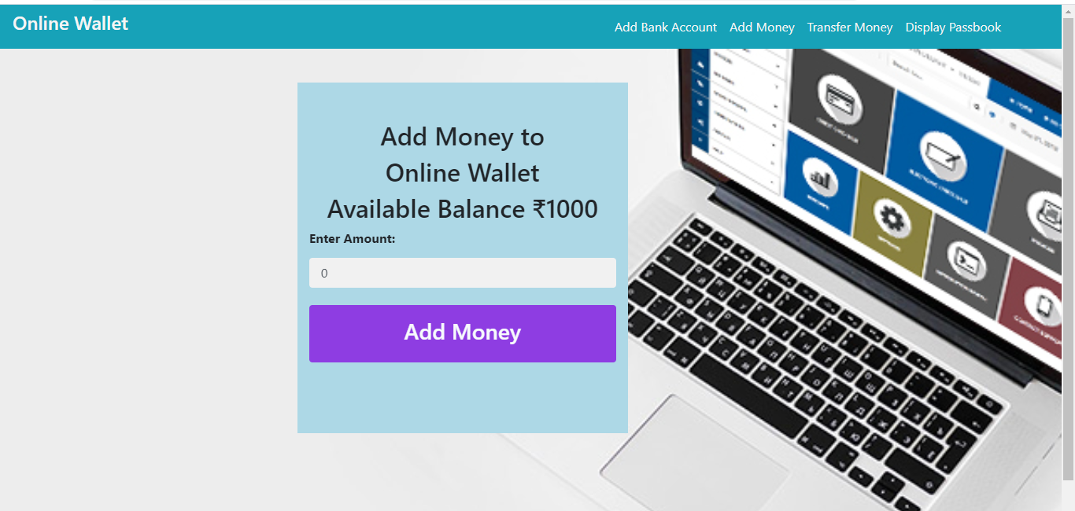
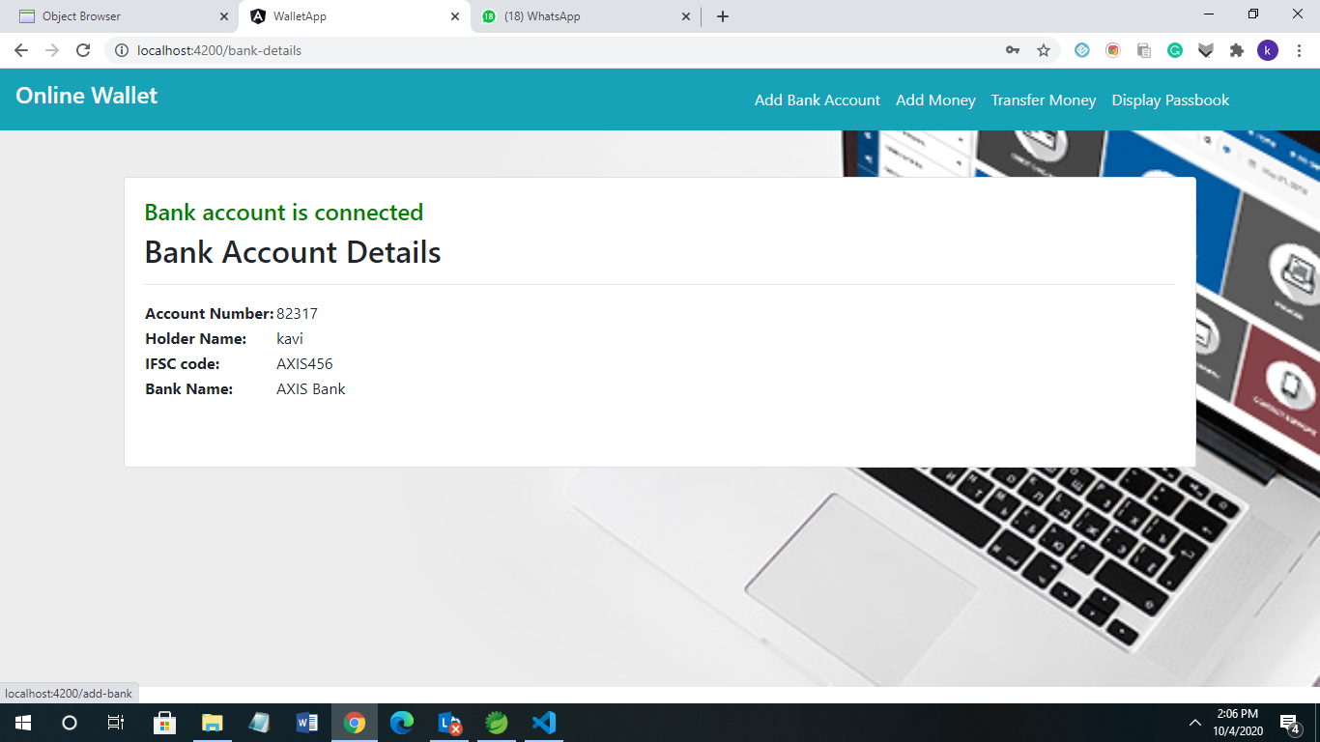
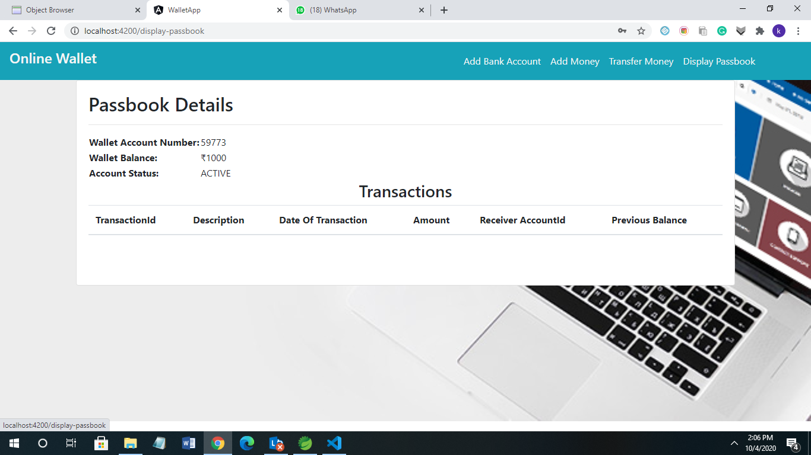

Slide 21
Thank you....

